Slide 1



CUTE – A low background facility for testing cryogenic detectors Installation Review Phase 2A
Serge Nagorny, CUTE Project Manager
on behalf Queen’s team of the CUTE facility
September 19th, 2018

Slide 2
Motivation
Test and validation of entire SuperCDMS detector tower (6 detector + electronics)
Measurements in a low background environment avoiding cosmogenic activation of detector’s material (³H, ³²Si, etc.)
Complete detector characterization to understand its intrinsic background and noise issues
Confirmation of screening program and handling procedures
Early science run for dark matter search can be performed thanks to low-background environment and low-energy threshold of SuperCDMS detectors

Slide 3
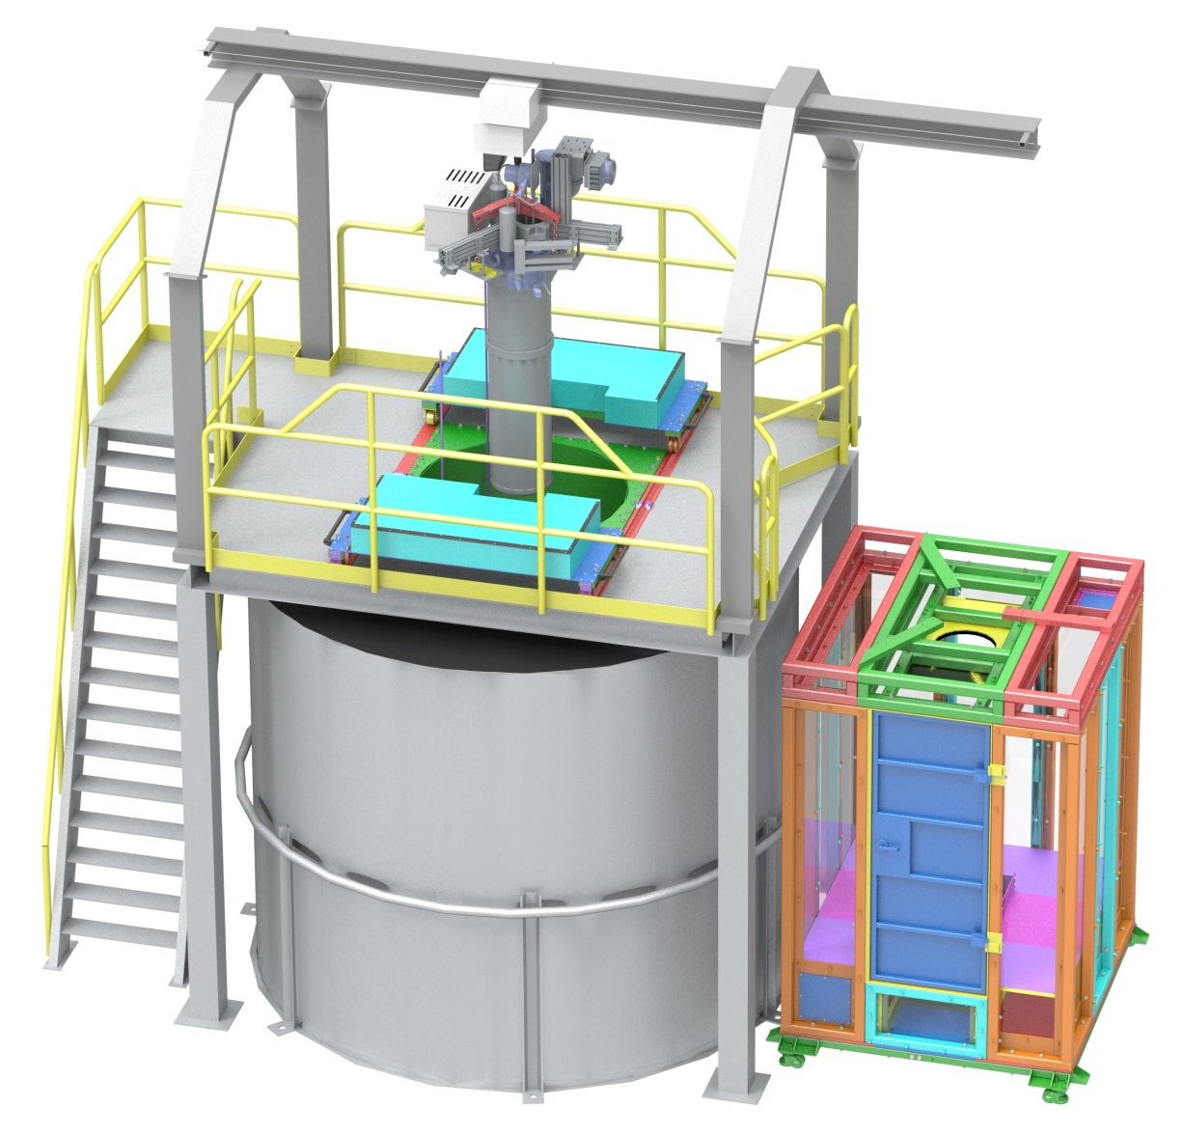
General view of the CUTE facility
Monorail with
1000 kg hoist
Cryostat
Drywell with
Pb shield/
Mu-metal
Platform
Cleanroom
Movable
HDPE shield
UP water
shield tank

Slide 4
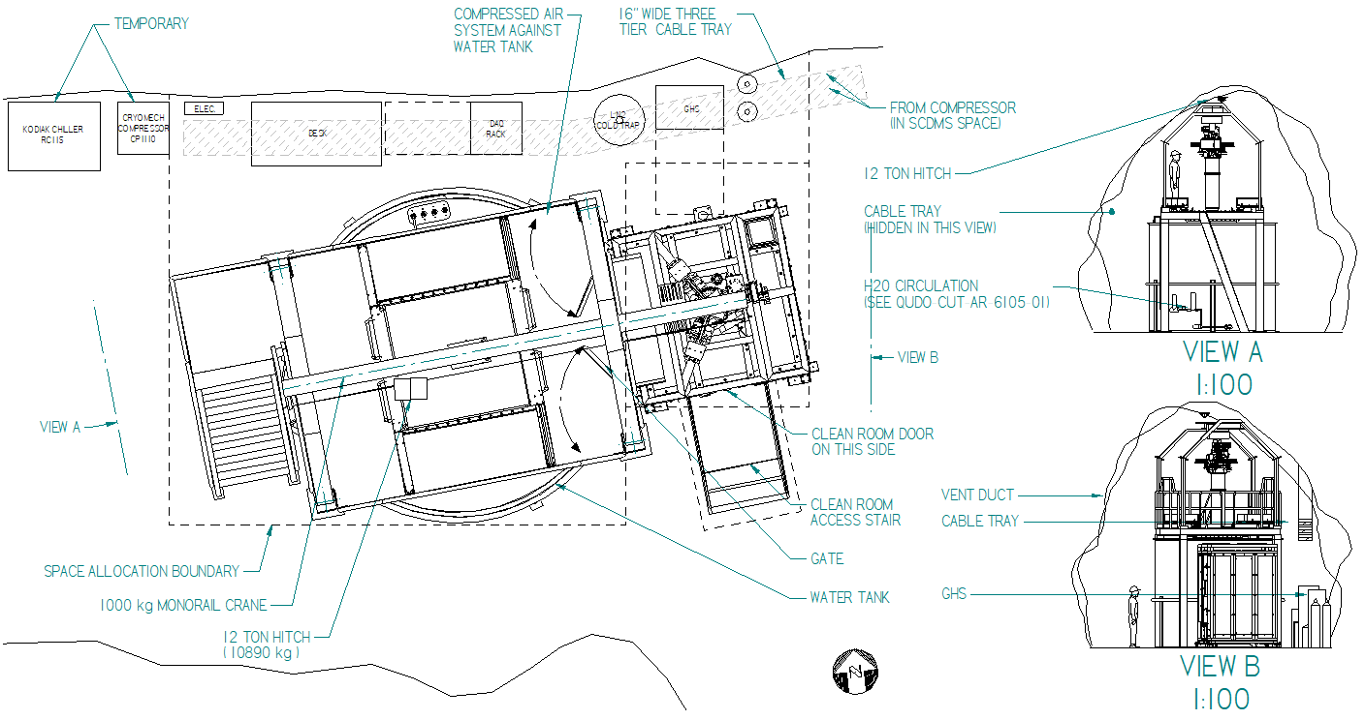
Arrangement
Recent changes in the CUTE facility layout
3/9/2016

Slide 5
Installation Review Phase 2A will include following items:
PE shield installation
Pb shield installation (including mu-metal)
Clean room installation
Network
All actions planned to be completed by Dec 2018

Slide 6
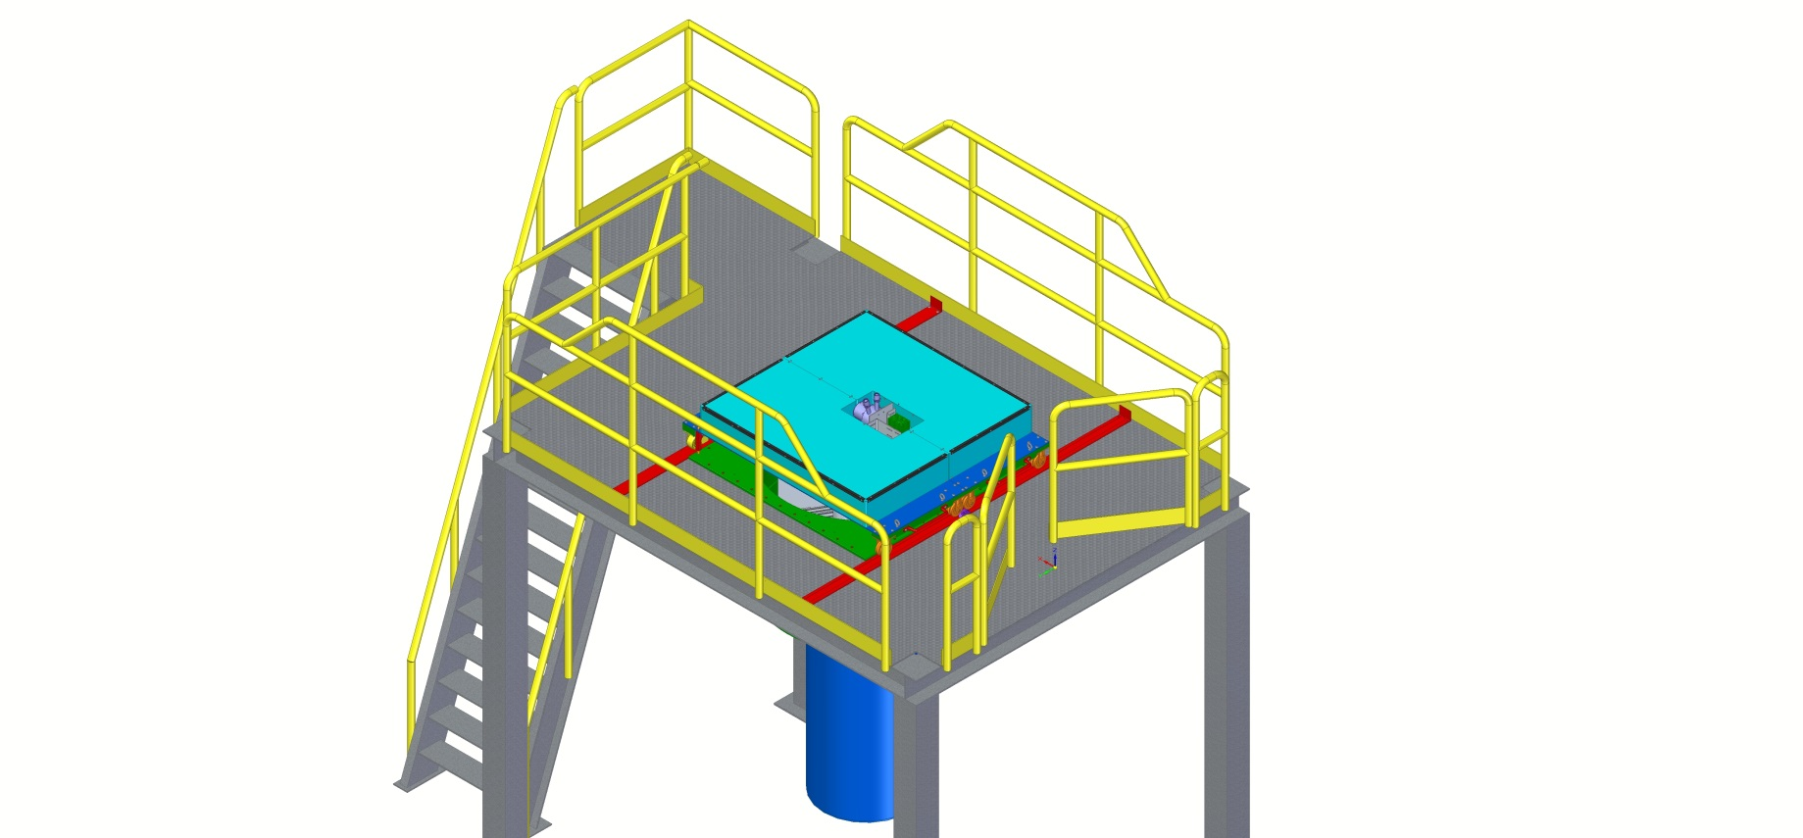
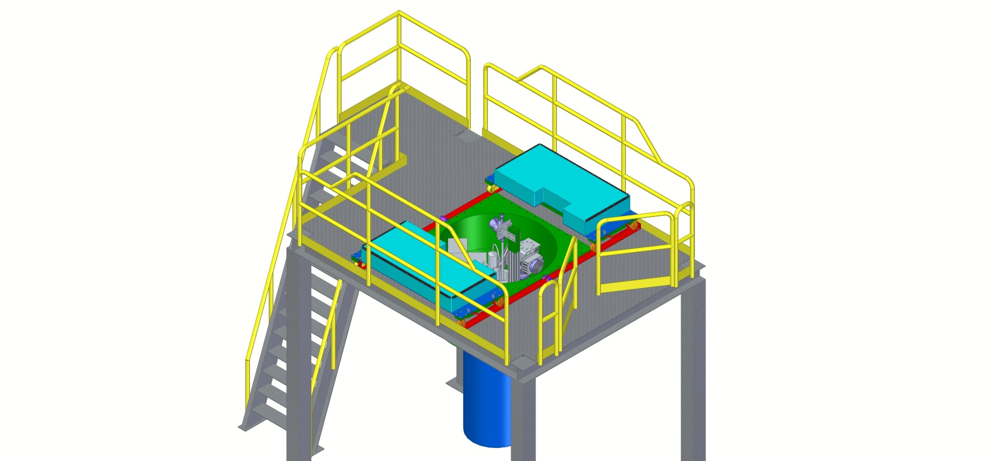
PE shielding
20 cm thick HDPE layer on top of the cryostat for neutron flux suppression
Produced, currently stored at site

Slide 7
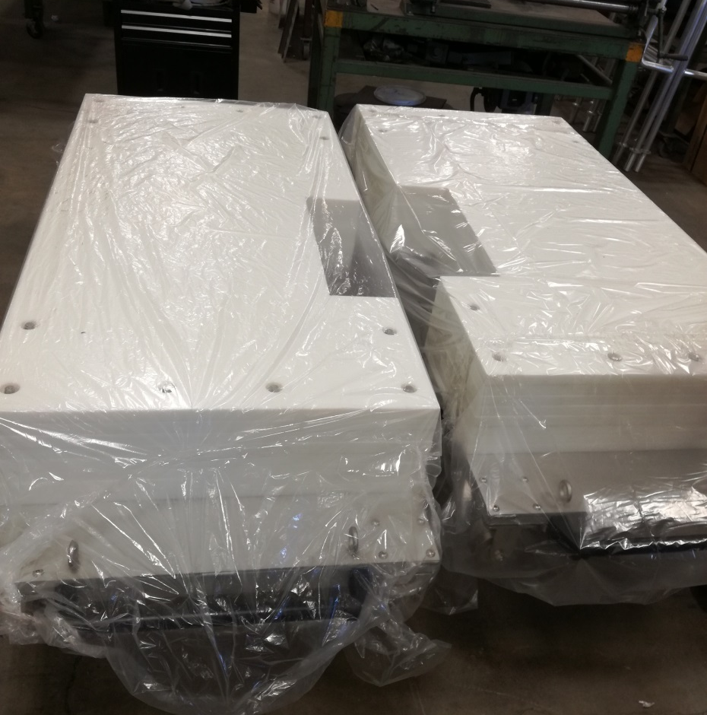
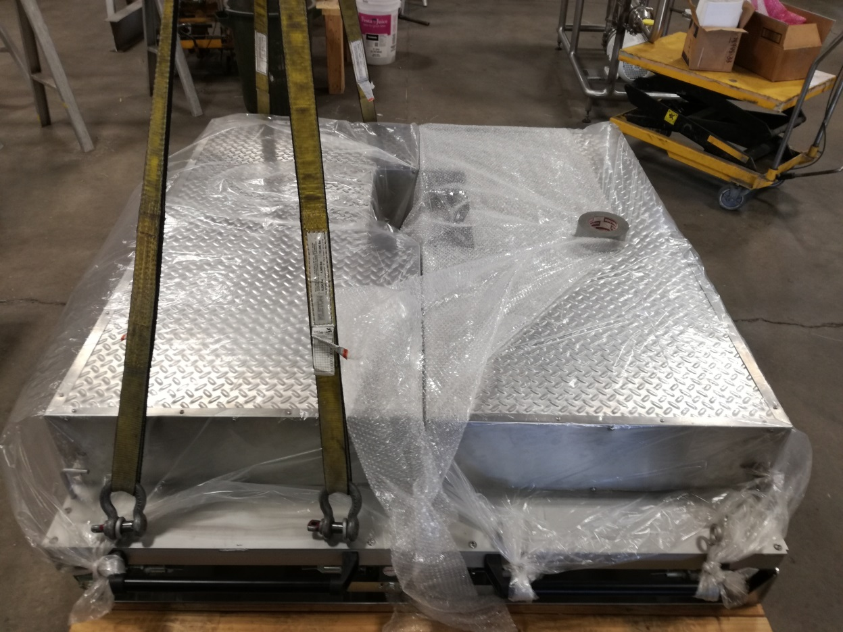
PE shield
8 layer of 1” HDPE sheet
Rigging/lifting test at producer site

Slide 8
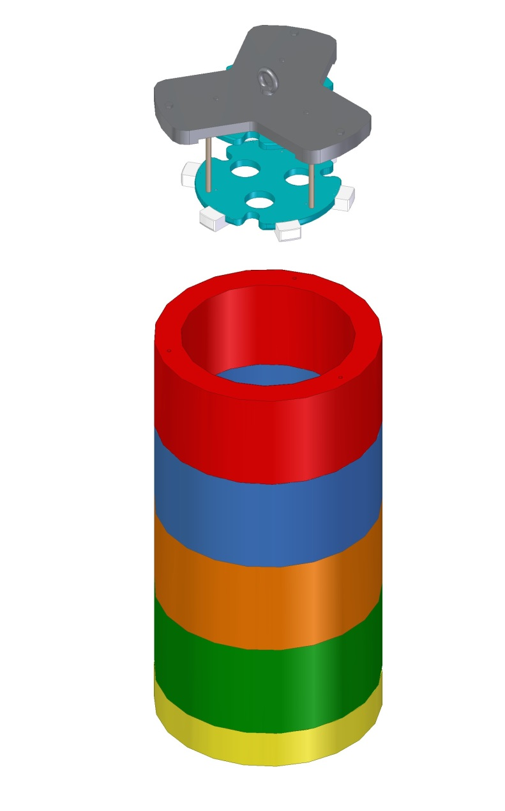
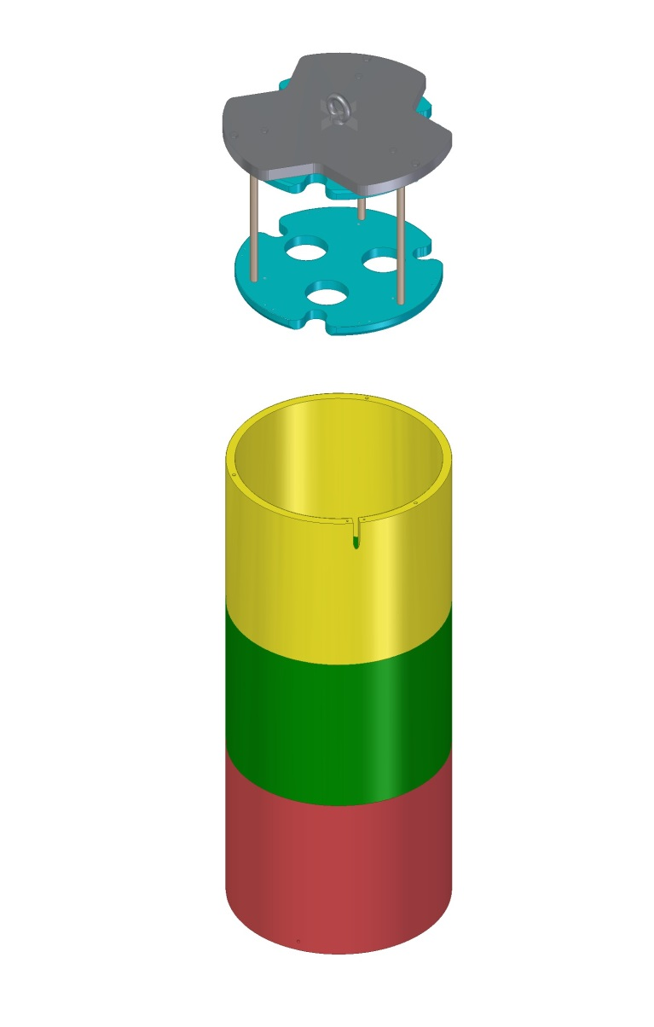
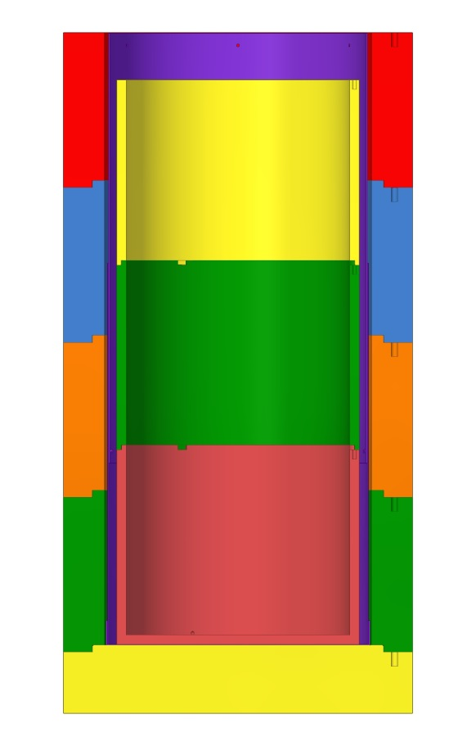
Lead shielding Produced, commissioning - Oct 2018, delivery to SNOLAB - end Oct 2018/beginning Nov 2018
9 cm
outer layer
650 kg
140 kg
2 cm
inner layer
13 cm
outer layer
Pb inner layer
< 3 Bq/kg
Pb outer layer
< 30 Bq/kg

Slide 9
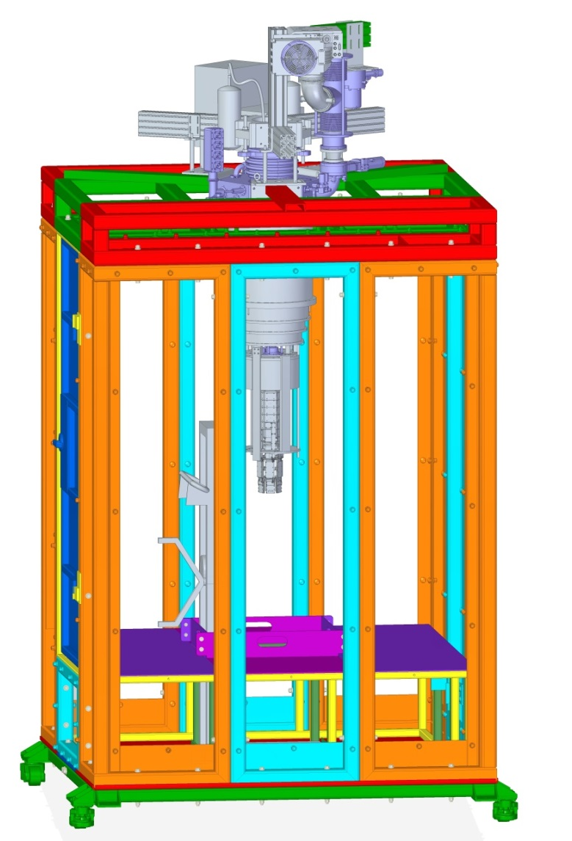
Cleanroom
Space for two operators
Aluminum structure with LEXAN panels
Resistant to seismic events
Movable
Lifting device for cryostat cans
Low Rn air supply (< 3 Bq/m³)
Later SuperCDMS Rn-filter system (< 0.1 Bq/m³) will be used
Crane moves cryostat between cleanroom and drywell

Slide 10
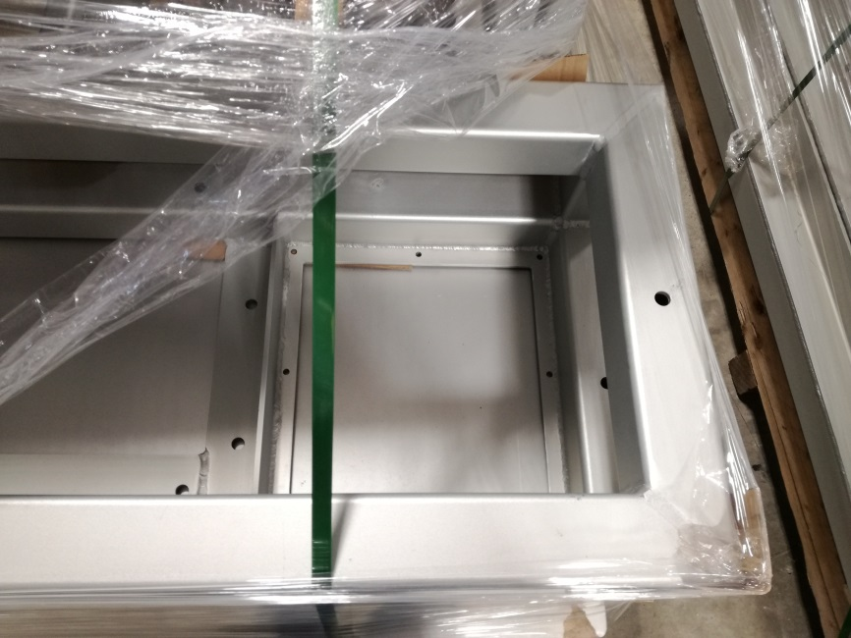
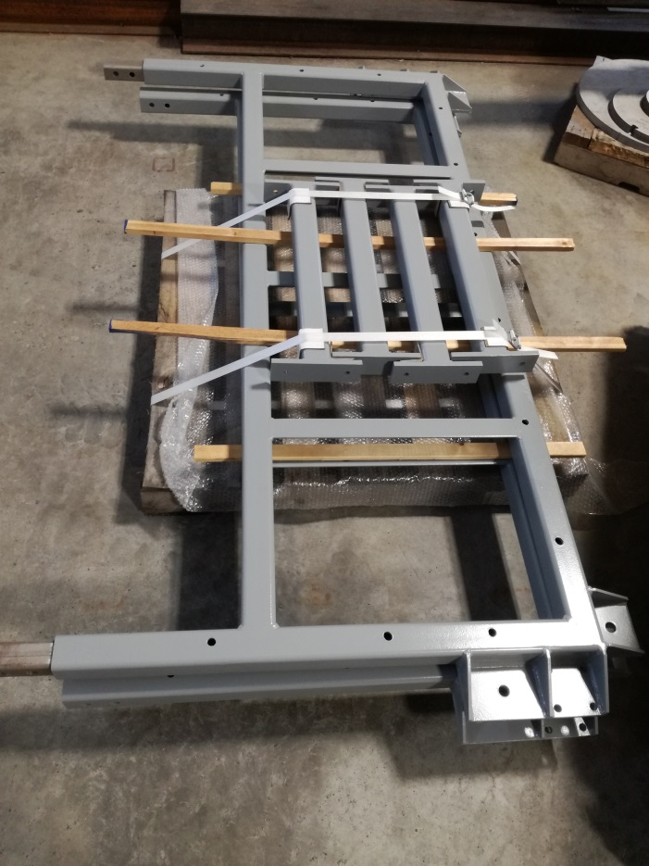
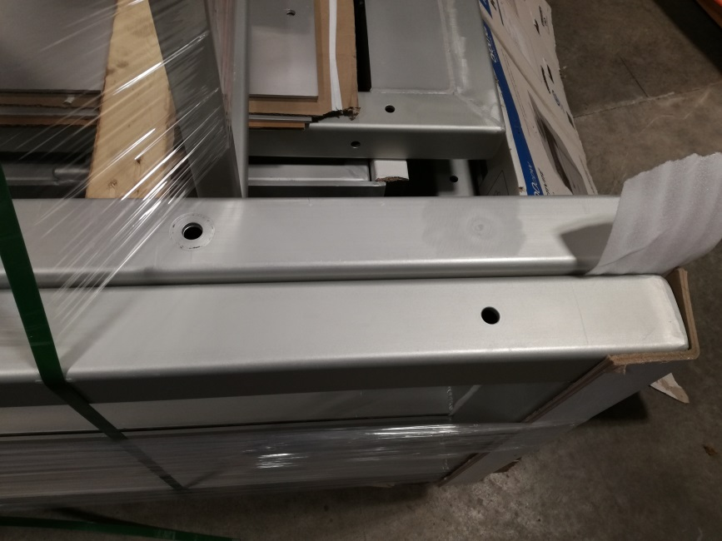
Cleanroom
Examples of Aluminum anodized frames
Bottom steel frame

Slide 11
Electrical/Network diagram
Electrical panel board
CUTE workstation
DAQ rack
power
phone
ethernet
Platform/top
Cleanroom/top
power
plug
power
phone
ethernet
phone
ethernet
Cleanroom/inside
power
phone
ethernet

Slide 12
6.15 Instrumentation Rack Installation '19 Jan 30 - '19 Feb 05
6.22 DAQ computer install '19 Jan 30 - '19 Feb 05
6.13 PT Compressor install '19 Jan 30 - '19 Feb 12
Clean Room at SNOLAB '18 Sep 24
Cryostat & Equip. at SNOLAB '18 Nov 30
Clean Room Final Inspection '18 Oct 26
PE Shield at SNOLAB '18 Aug 08
6.12 Dilution GHS Installation '19 Jan 30 - '19 Feb 12
Magnetic Shield at SNOLAB '18 Sep 18
Lead Shield at SNOLAB '18 Nov 12
Start '18 Jun 01
'18 Jun
'18 Jul
'18 Aug
'18 Sep
'18 Oct
'18 Nov
'18 Dec
'19 Jan
'19 Feb
'19 Mar
Finish '19 Apr 01
6.6 Electrical Power Distribution '17 Nov 30 - '18 Sep 17
6.23 Temp Water Chiller/Compressor '18 Oct 17 - '18 Nov 27
Cryostat Installation '19 Feb 13 - '19 Mar 26
Cryostat inst
6.9 Instrument Air '18 Jul 24 - '18 Nov 12
6.14 Cryostat Design/Installation '18 Jul 24 - '19 Mar 26
6.10 Network and Communications '18 Aug 08 - '18 Oct 15
6.11 Cryostat & Equipment Shipping '18 Nov 05 - '18 Dec 14
6.16 Clean Room Fab/Install '18 Aug 08 - '18 Oct 26
6.17 PE Shield install '18 Aug 08 - '18 Oct 12
6.18 Magnetic Shield Design/Install '18 Aug 08 - '18 Dec 20
6.19 Lead Shield Install '18 Aug 08 - '18 Dec 20
6.20 Gamma System '18 Aug 31 - '19 Feb 28
Suspension System at SNOLAB '18 Dec 21
Operation Readiness Review '19 Mar 12
Tank Fill Complete '18 Oct 10
Installation Review - Phase 2B Infrastructure '19 Jan 15
6.2 Liners and Lid Installation '18 Sep 24 - '18 Oct 10
SNOLAB Approval - Phase 2A Installation '18 Oct 10
SNOLAB Approval - Phase 2B Installation '19 Jan 29
SNOLAB Approval Operations '19 Mar 26

Slide 13
CUTE tasks till Operation with SuperCDMS detectors (1)
Step | Time required
Suspension system test @ Queen’s (first test, calibration of sensors, installation procedure development, operation procedure development ) | Oct 2018
Cryostat pieces cleaning | Oct 2018
Cryostat pieces shipped to SNOLAB | till Dec 2018
Calibration system production | till Nov 2018
Preparation for Installation Review ph 2B (cryostat, suspension system, calibration system, DAQ + electronics) | till Jan 2019
Preparation for Operational Readiness Review | till March 2019
Cleanroom operation test (air quality test, operational test, working procedure improvement) | till June 2019
Radio-assay of materials used for CUTE facility production | during 2018-2019
Completion of CUTE background model | till June 2019

Slide 14
CUTE tasks till Operation with SuperCDMS detectors (2)
Step | Time required
Calibration system production | till Nov 2018
¹³³Ba gamma source encapsulation (encapsulation and assay) | till Nov 2018
Production of transportation system for cryostat | till Jan 2019
Get Light, Electrical and Ethernet connections ready to use | depends on SNOLAB
Develop DAQ architecture for underground/surface CUTE lab | till end 2018
Test all procedures , its correction based on the results of first run with/without G115 | before June 2019
Evaluation of required manpower for run preparation, running | Before June 2019

Slide 15
CUTE facility commissioning before SuperCDMS detector operation
Test of electronics components | DCRC boards VIB board Cables Pi-filters Power supply DAQ
Test of data handling system | Data quality procedure Transfer of raw data from DAQ to surface Access to surface/underground from outside
Calibration system test | Counting rate Data flow during calibration Remote functioning
Background evaluation | Background rate at ROI
Suspension system test | Running in different environmental conditions Effect to the detector
Coordination between CUTE-SuperCDMS teams | Develop the protocol of info/data exchange Responsibility sharing

Slide 16
Payload for CUTE
Commissioning
Task | Time Period
Testing of CUTE facility at SNOLAB Without detectors With G115 detector/TES chips Revision/fixing problems/commissioning | March 2019 – June 2019
Si HV Pathfinder detector test | July 2019 – August 2019
First SuperCDMS tower (6 iZIP Ge detector) | September 2019 – May 2020
Operation

Slide 17
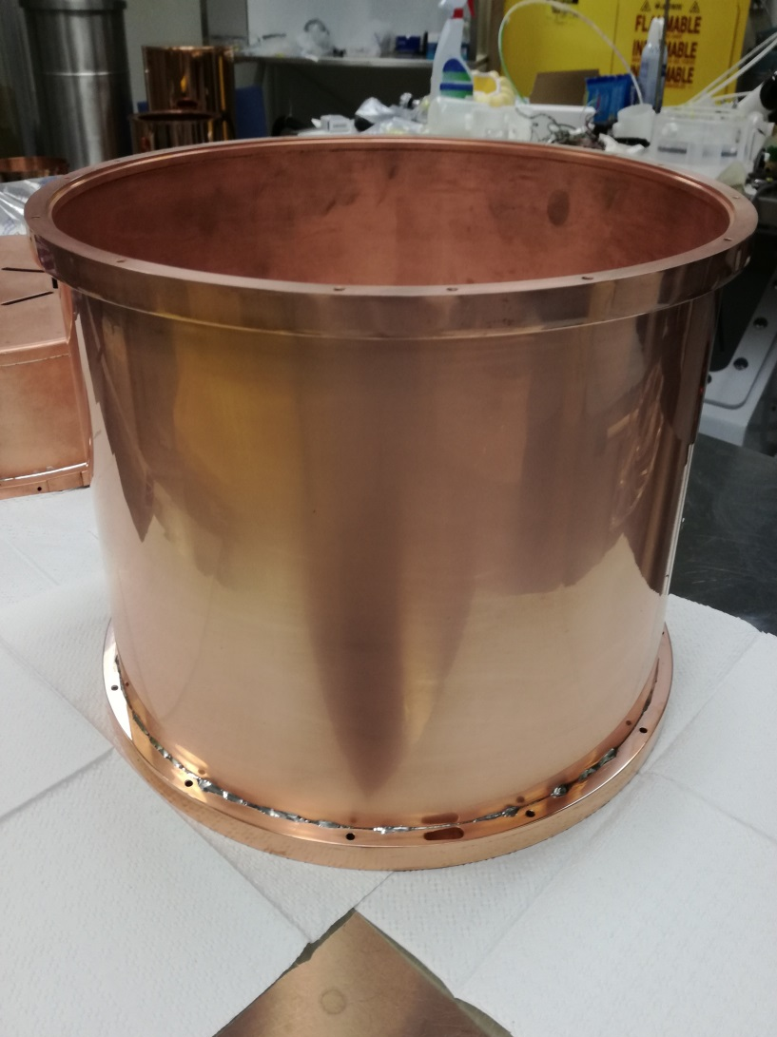
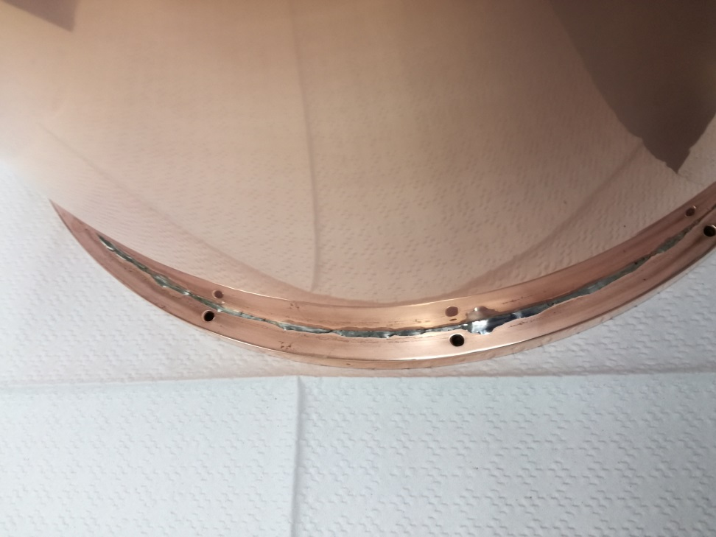
Copper pieces cleanning

Slide 18
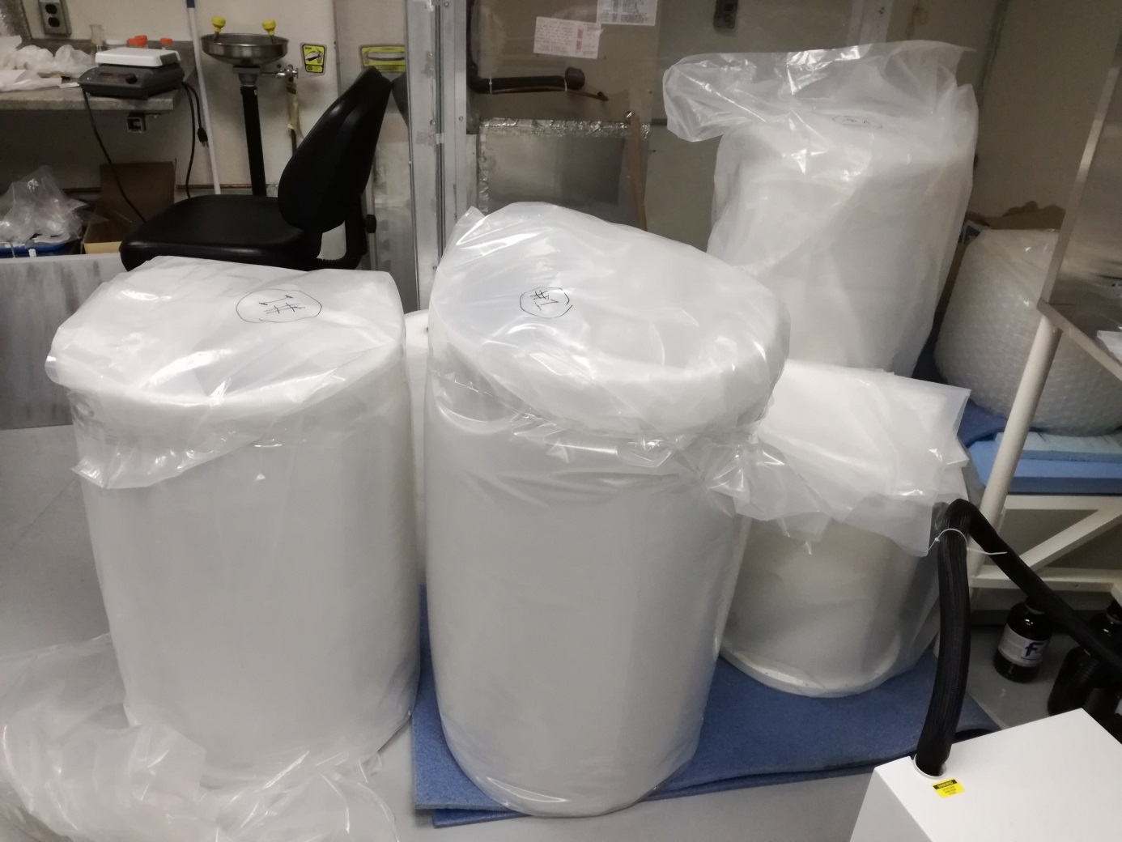
Cleaning of cryostat parts
Copper cans
Magnetic shield

Slide 19
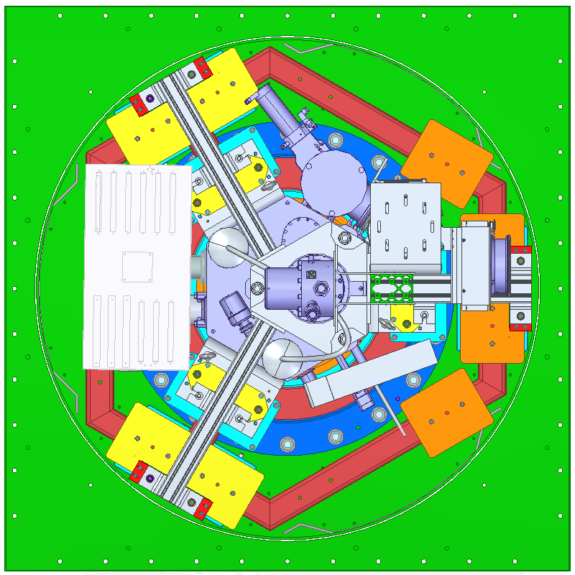
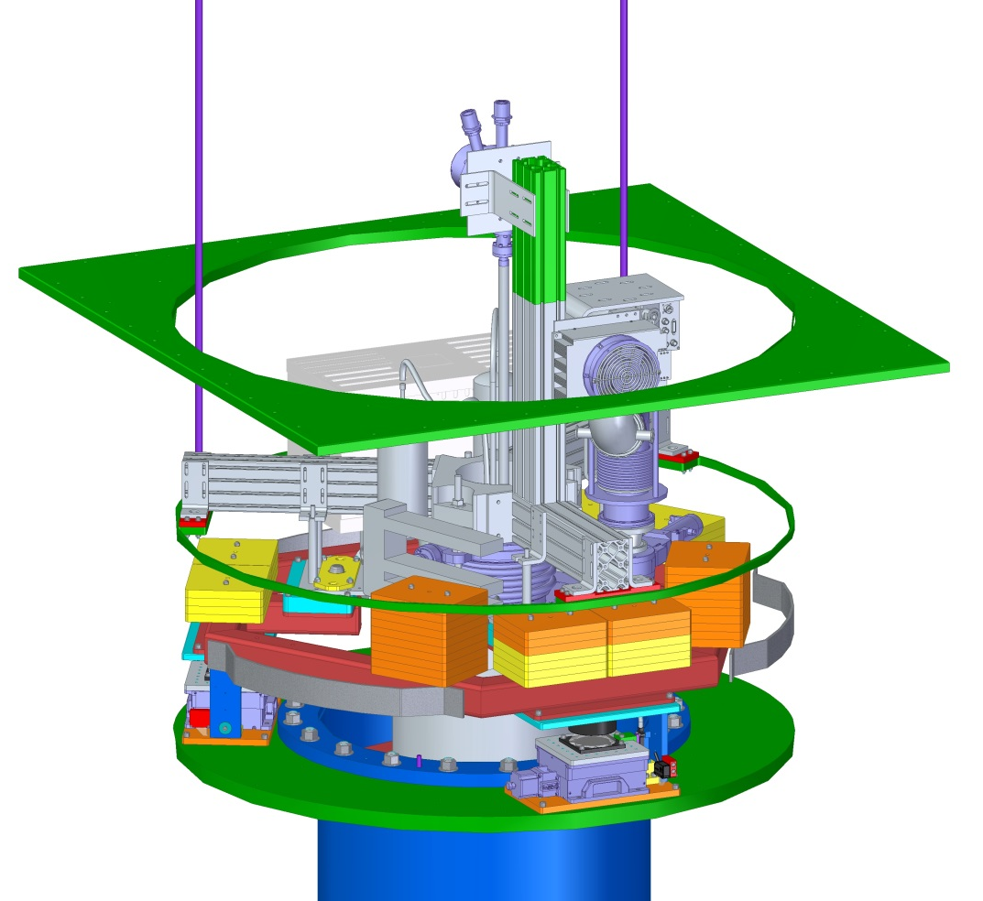
Suspension system assembly
electronics box
pulse tube
drywell
turbopump
supporting frame
added masses
(about 400 kg)
damper

Slide 20
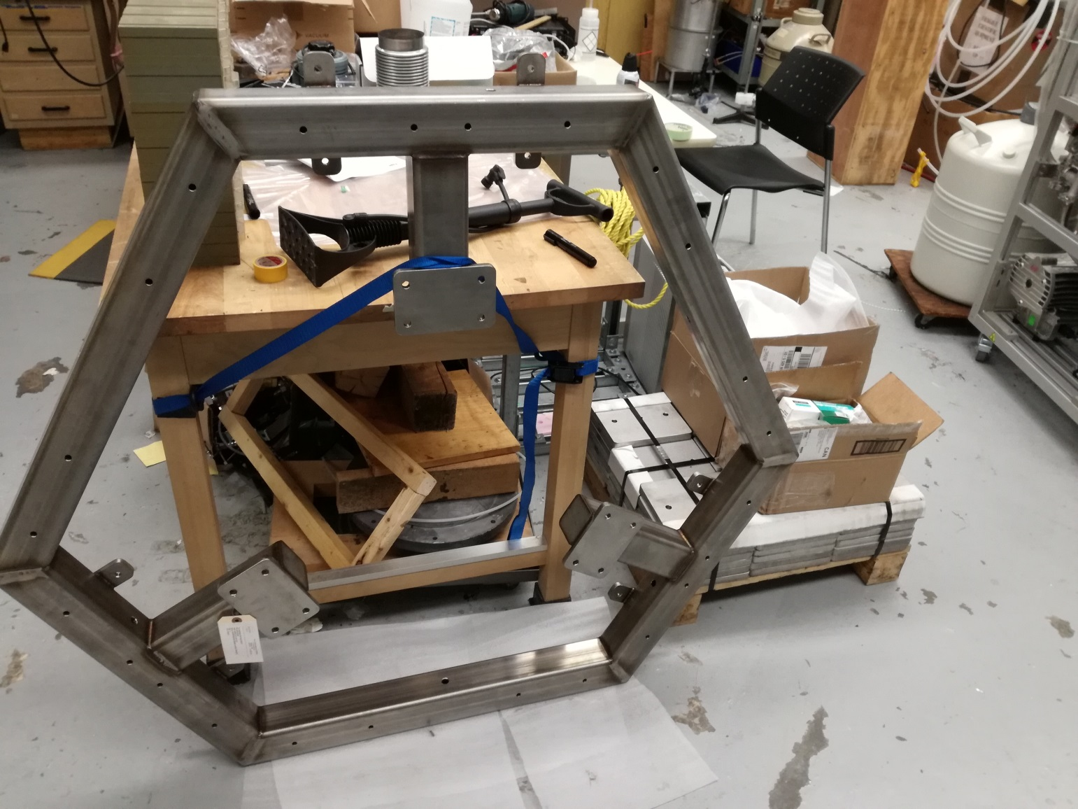
Current status
accessories
added masses
(about 400 kg)
supporting frame

Slide 21
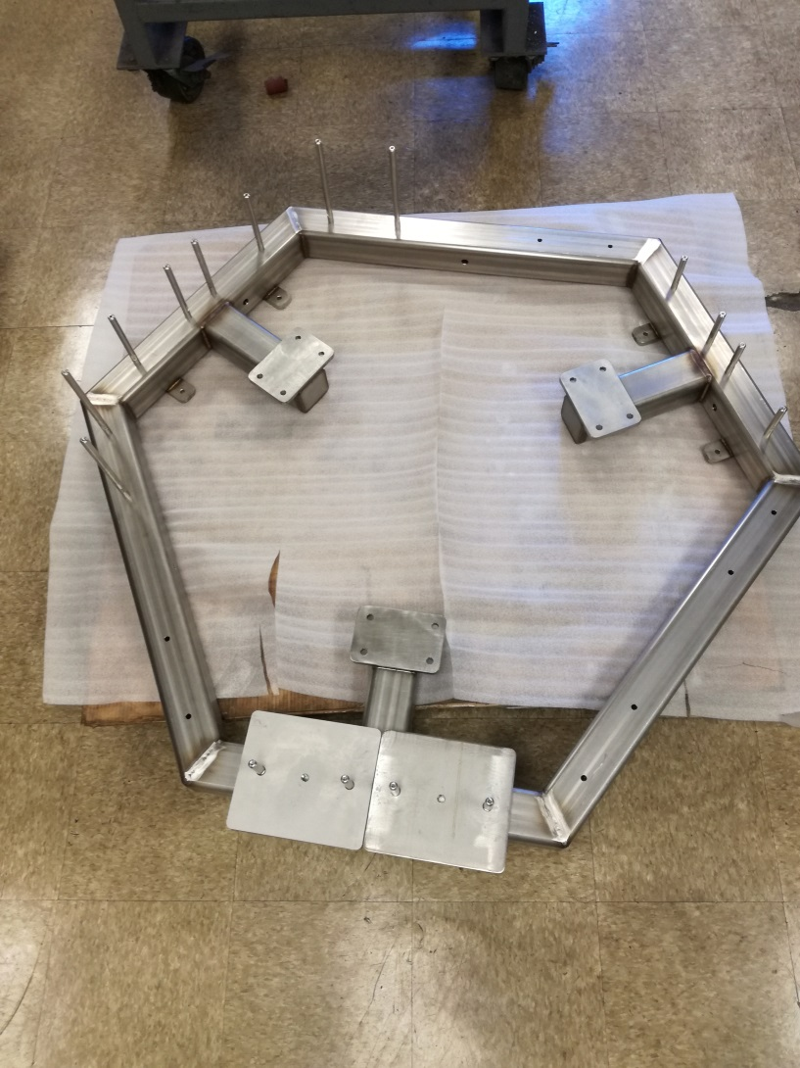
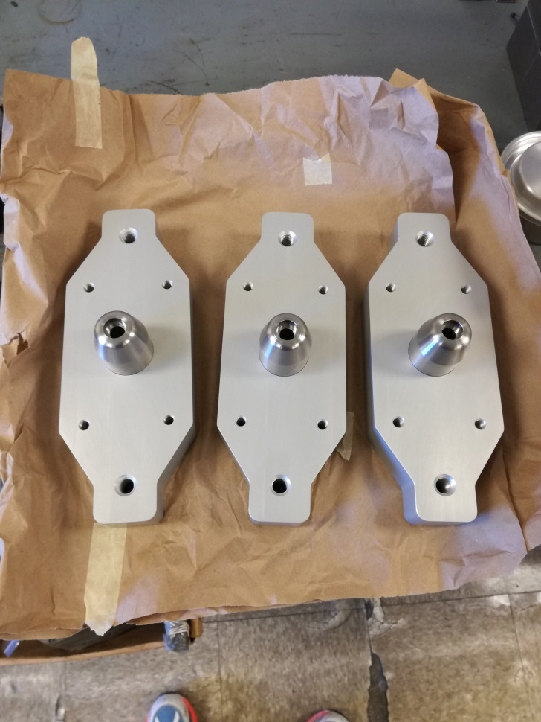
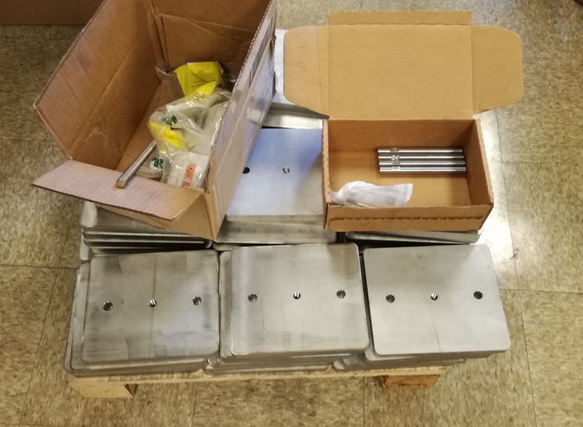
Current status
Alignment plates
added masses
(about 400 kg)

